Slide 1

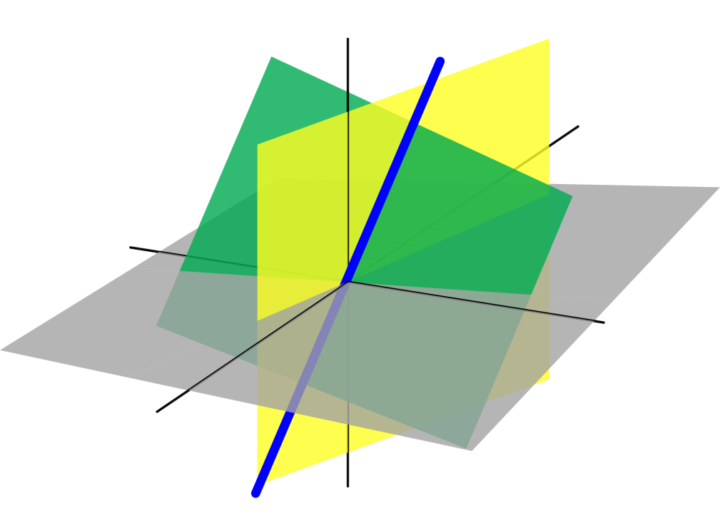
Azərbaycan Dövlət Neft və Sənaye Universiteti
Analytic Geometry

Slide 2
Plane Analytic Geometry

Slide 3
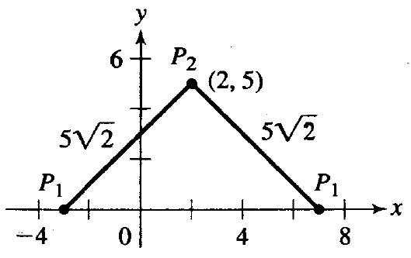
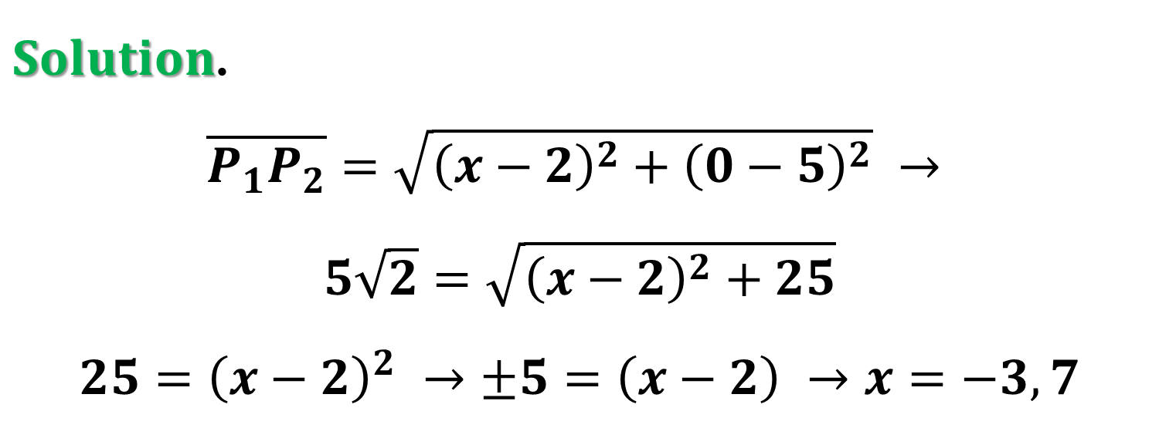
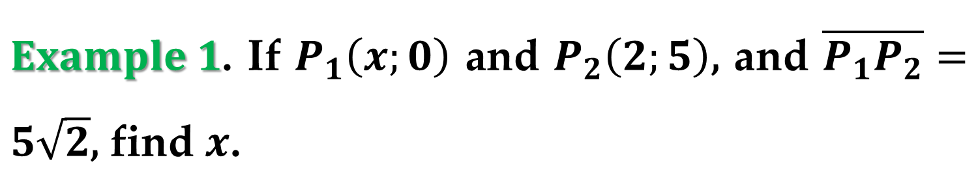
$Example 1$. If $P_{1}\left(x;0\right)$ and $P_{2}\left(2;5\right)$, and $\overline{P_{1}P_{2}}=5\sqrt{2}$, find $x$.
$Solution$.
$$\overline{P_{1}P_{2}}=\sqrt{{\left(x−2\right)}^{2}+{\left(0−5\right)}^{2}} →$$
$$5\sqrt{2}=\sqrt{{\left(x−2\right)}^{2}+25}$$
$$25={\left(x−2\right)}^{2} →±5=\left(x−2\right) →x=−3, 7$$

Slide 4
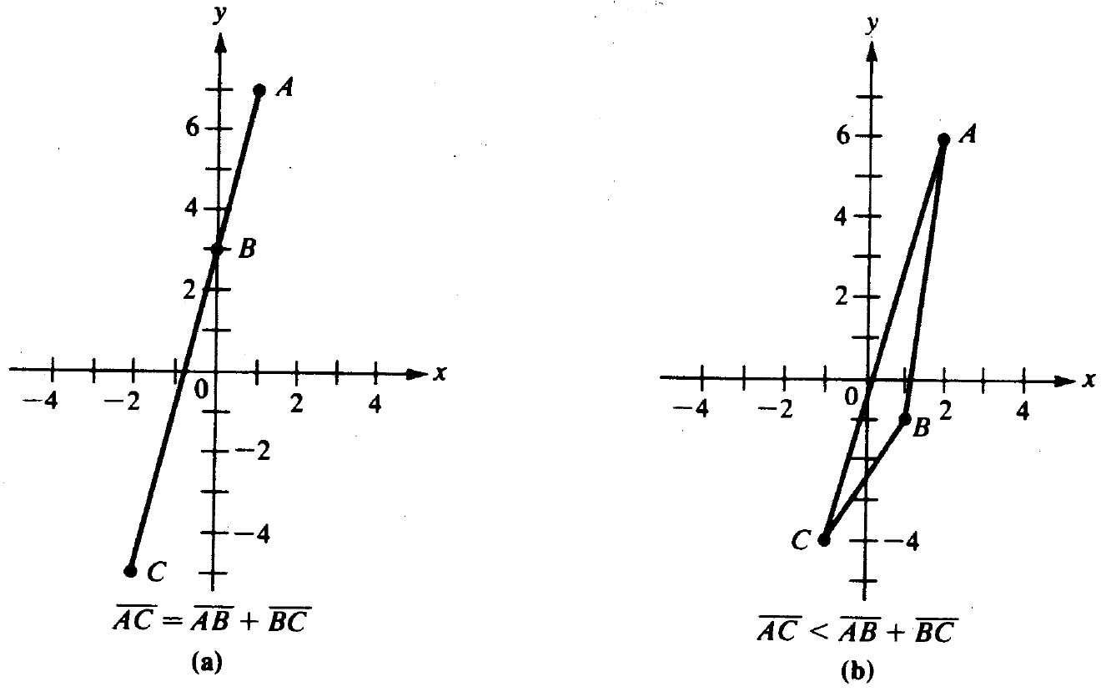
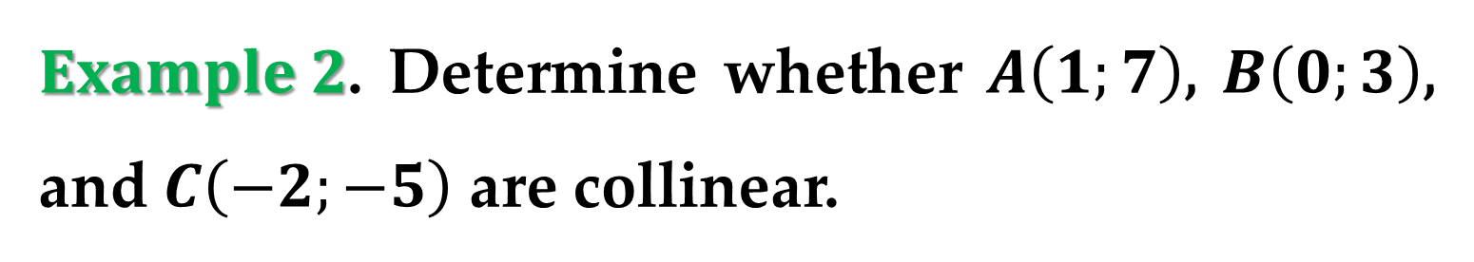
$Example 2$. Determine whether $A\left(1;7\right)$, $B\left(0;3\right)$, and $C\left(−2;−5\right)$ are collinear.

Slide 5
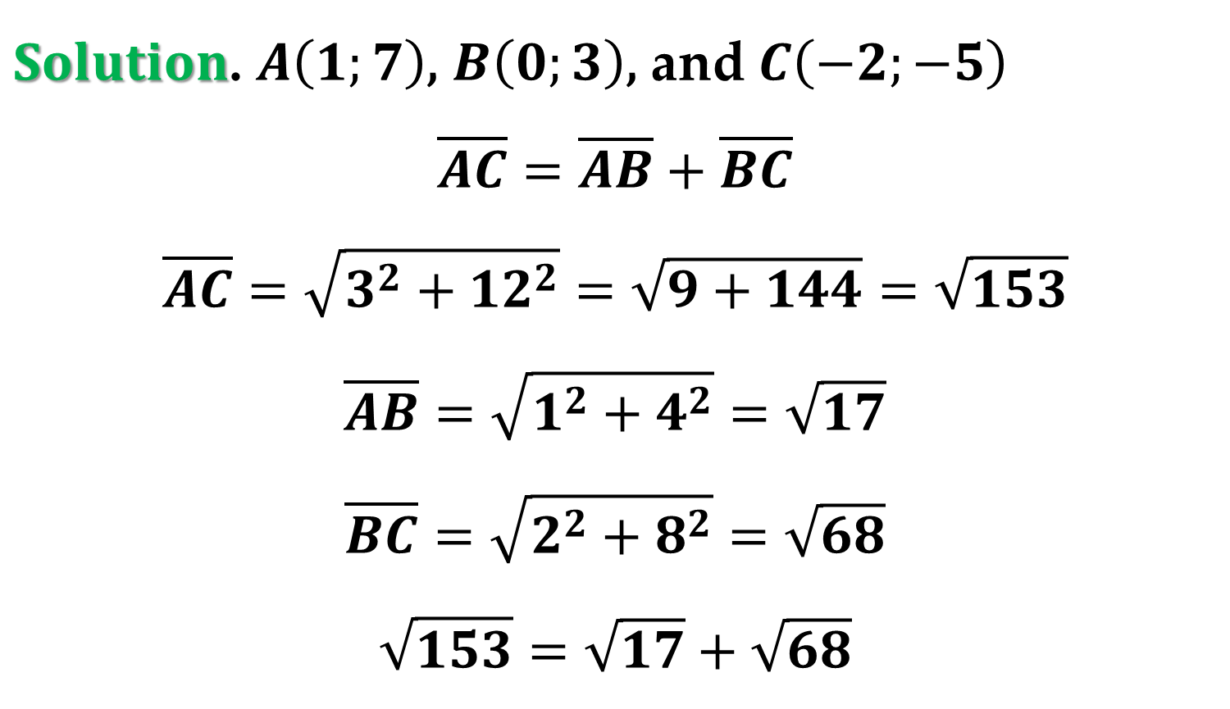
$Solution$. $A\left(1;7\right)$, $B\left(0;3\right)$, and $C\left(−2;−5\right)$
$$\overline{AC}=\overline{AB}+\overline{BC}$$
$$\overline{AC}=\sqrt{3^{2}+12^{2}}=\sqrt{9+144}=\sqrt{153}$$
$$\overline{AB}=\sqrt{1^{2}+4^{2}}=\sqrt{17}$$
$$\overline{BC}=\sqrt{2^{2}+8^{2}}=\sqrt{68}$$
$$\sqrt{153}=\sqrt{17}+\sqrt{68}$$

Slide 6
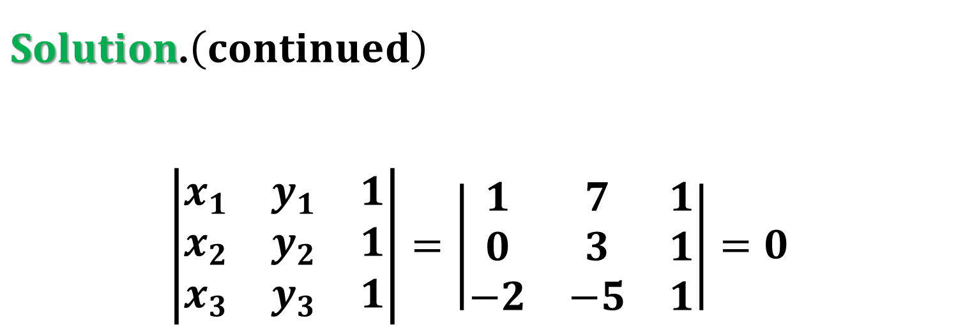
$Solution$.$\left(continued\right)$
$$\left|\begin{matrix}x_{1} & y_{1} & 1 \\ x_{2} & y_{2} & 1 \\ x_{3} & y_{3} & 1\end{matrix}\right|=\left|\begin{matrix}1 & 7 & 1 \\ 0 & 3 & 1 \\ −2 & −5 & 1\end{matrix}\right|=0$$

Slide 7
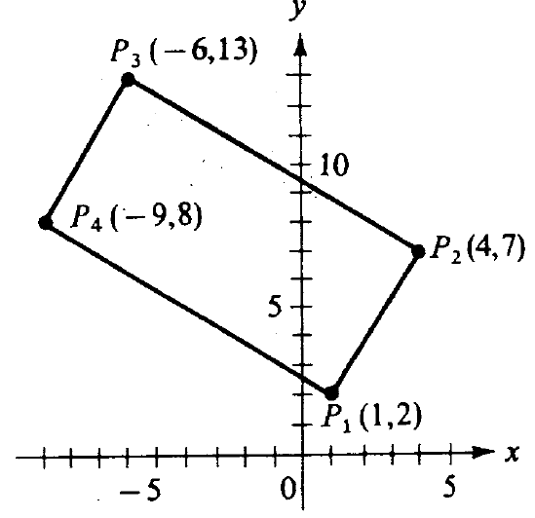
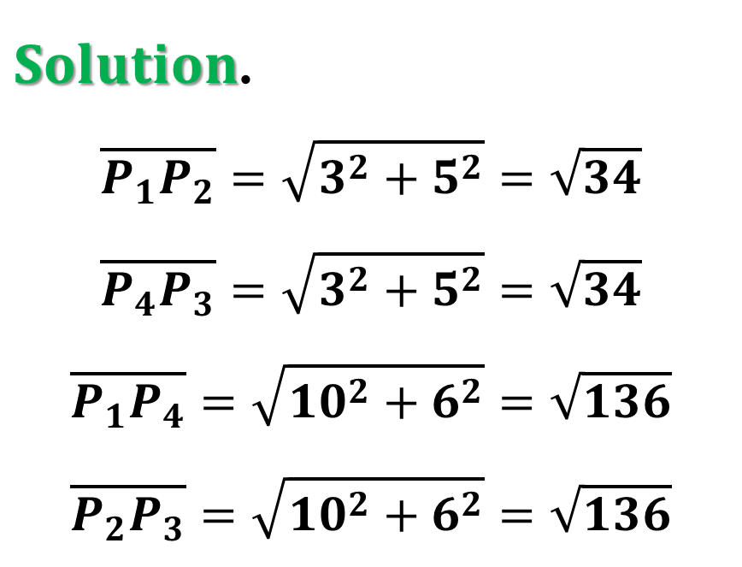
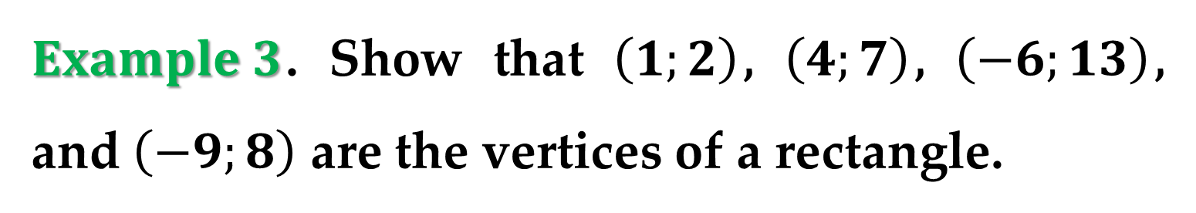
$Example 3$. Show that $\left(1;2\right)$, $\left(4;7\right)$, $\left(−6;13\right)$, and $\left(−9;8\right)$ are the vertices of a rectangle.
$Solution$.
$$\overline{P_{1}P_{2}}=\sqrt{3^{2}+5^{2}}=\sqrt{34}$$
$$\overline{P_{4}P_{3}}=\sqrt{3^{2}+5^{2}}=\sqrt{34}$$
$$\overline{P_{1}P_{4}}=\sqrt{{10}^{2}+6^{2}}=\sqrt{136}$$
$$\overline{P_{2}P_{3}}=\sqrt{{10}^{2}+6^{2}}=\sqrt{136}$$

Slide 8
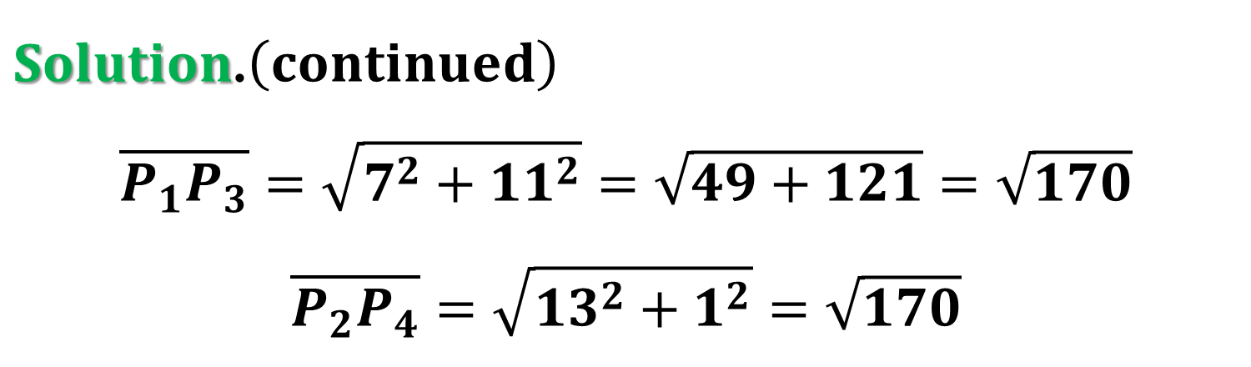
$Solution$.$\left(continued\right)$
$$\overline{P_{1}P_{3}}=\sqrt{7^{2}+11^{2}}=\sqrt{49+121}=\sqrt{170}$$
$$\overline{P_{2}P_{4}}=\sqrt{13^{2}+1^{2}}=\sqrt{170}$$

Slide 9
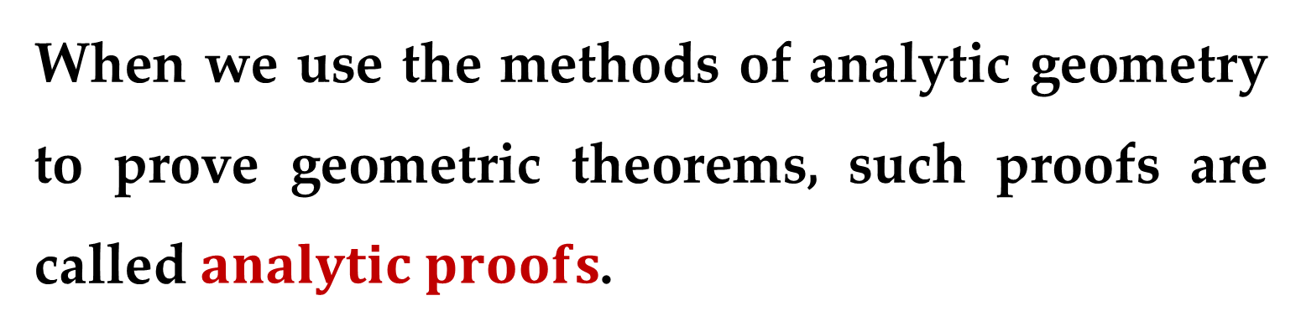
When we use the methods of analytic geometry to prove geometric theorems, such proofs are called $analytic proofs$.
When carrying out analytic proofs, we should recall that a plane does not come fully equipped with coordinate axes – they are imposed upon the plane to make the transition from geometry to algebra.

Slide 10
Thus, we are free to place the axes in any position we choose in relation to the given figure.
We place them in a way that makes the algebra as simple as possible.
However, we must be careful not to make additional assumptions about the figure.

Slide 11
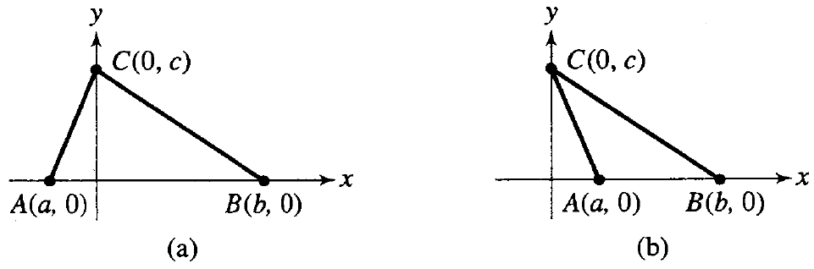
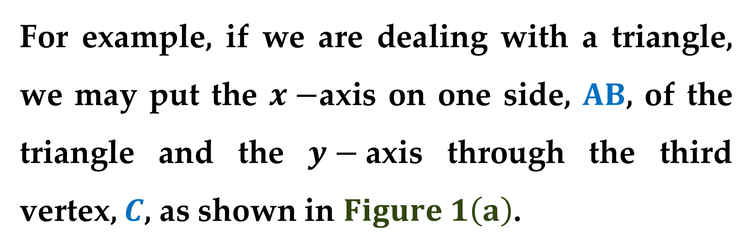
For example, if we are dealing with a triangle, we may put the $x−$axis on one side, $AB$, of the triangle and the $y−$axis through the third vertex, $C$, as shown in $Figure 1\left(a\right)$.

Slide 12
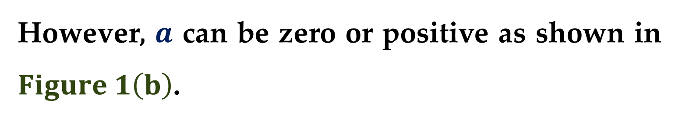
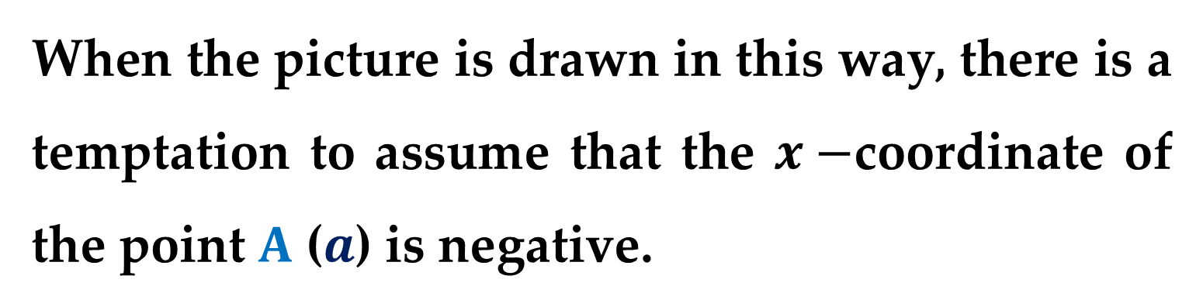
When the picture is drawn in this way, there is a temptation to assume that the $x−$coordinate of the point $A$ ($a$) is negative.
However, $a$ can be zero or positive as shown in $Figure 1\left(b\right)$.
The assumption that it is negative may invalidate your proof.
Be aware of such dangers.

Slide 13
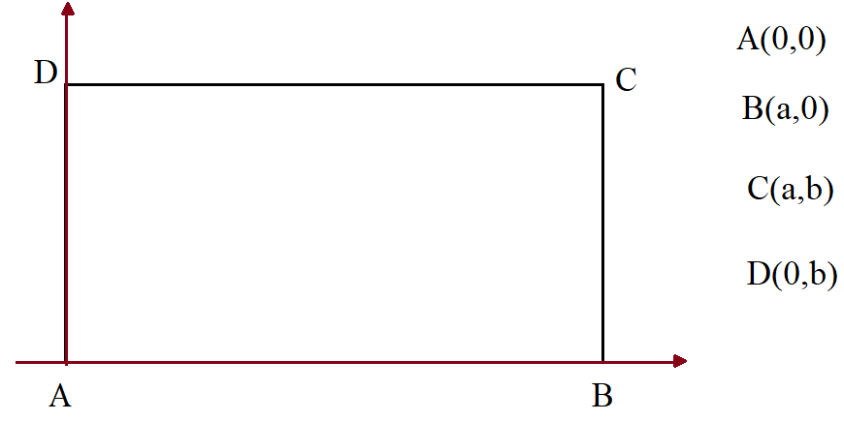
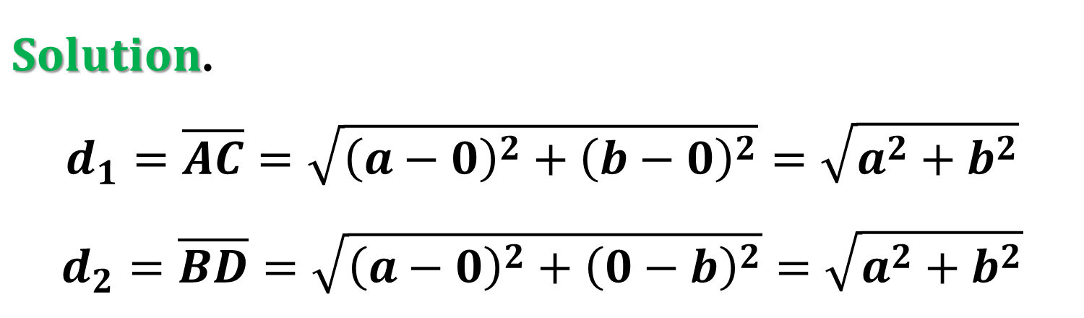
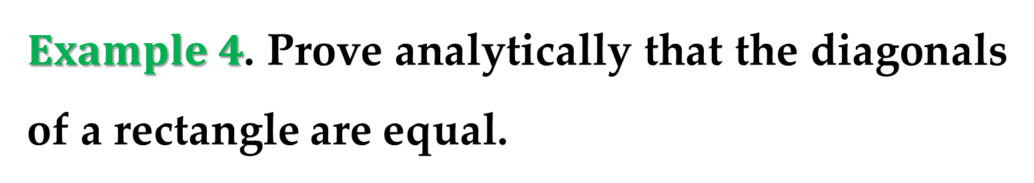
$Example 4$. Prove analytically that the diagonals of a rectangle are equal.
$Solution$.
$$d_{1}=\overline{AC}=\sqrt{{\left(a−0\right)}^{2}+{\left(b−0\right)}^{2}}=\sqrt{a^{2}+b^{2}}$$
$$d_{2}=\overline{BD}=\sqrt{{\left(a−0\right)}^{2}+{\left(0−b\right)}^{2}}=\sqrt{a^{2}+b^{2}}$$

Slide 14
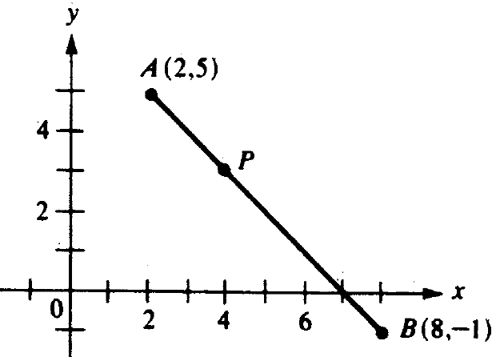
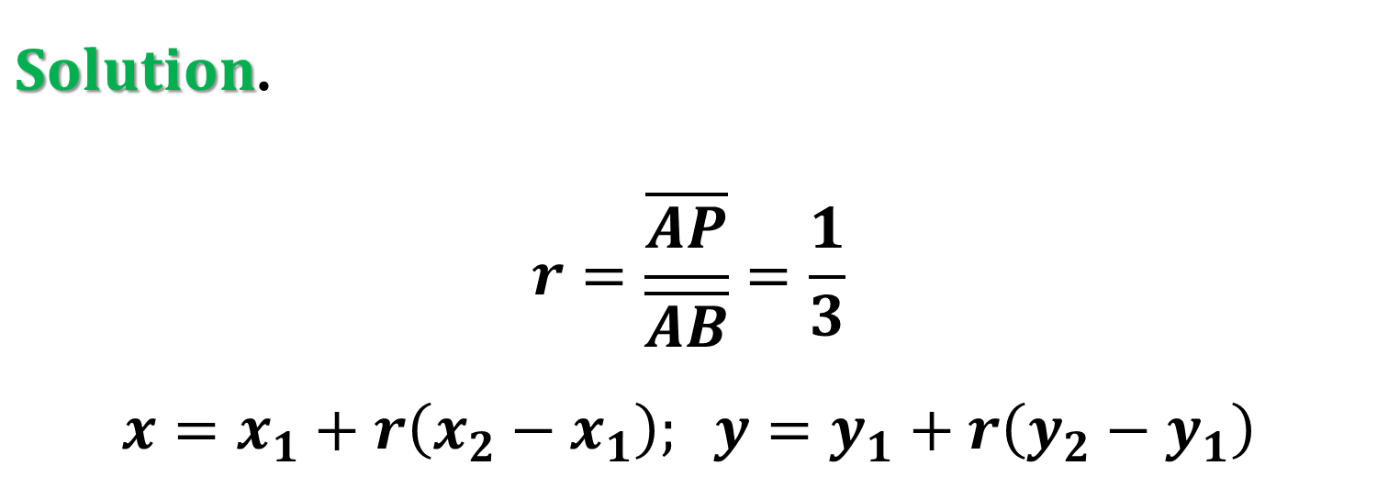
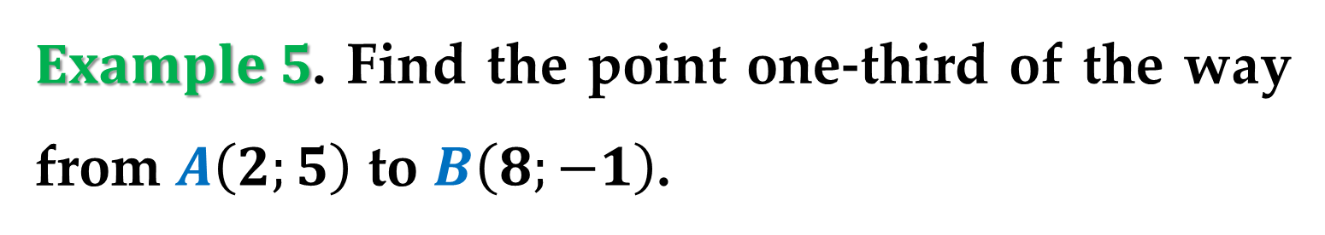
$Example 5$. Find the point one-third of the way from $A\left(2;5\right)$ to $B\left(8;−1\right)$.
$Solution$.
$$r=\frac{\overline{AP}}{\overline{AB}}=\frac{1}{3}$$
$$x=x_{1}+r\left(x_{2}−x_{1}\right); y=y_{1}+r\left(y_{2}−y_{1}\right)$$

Slide 15
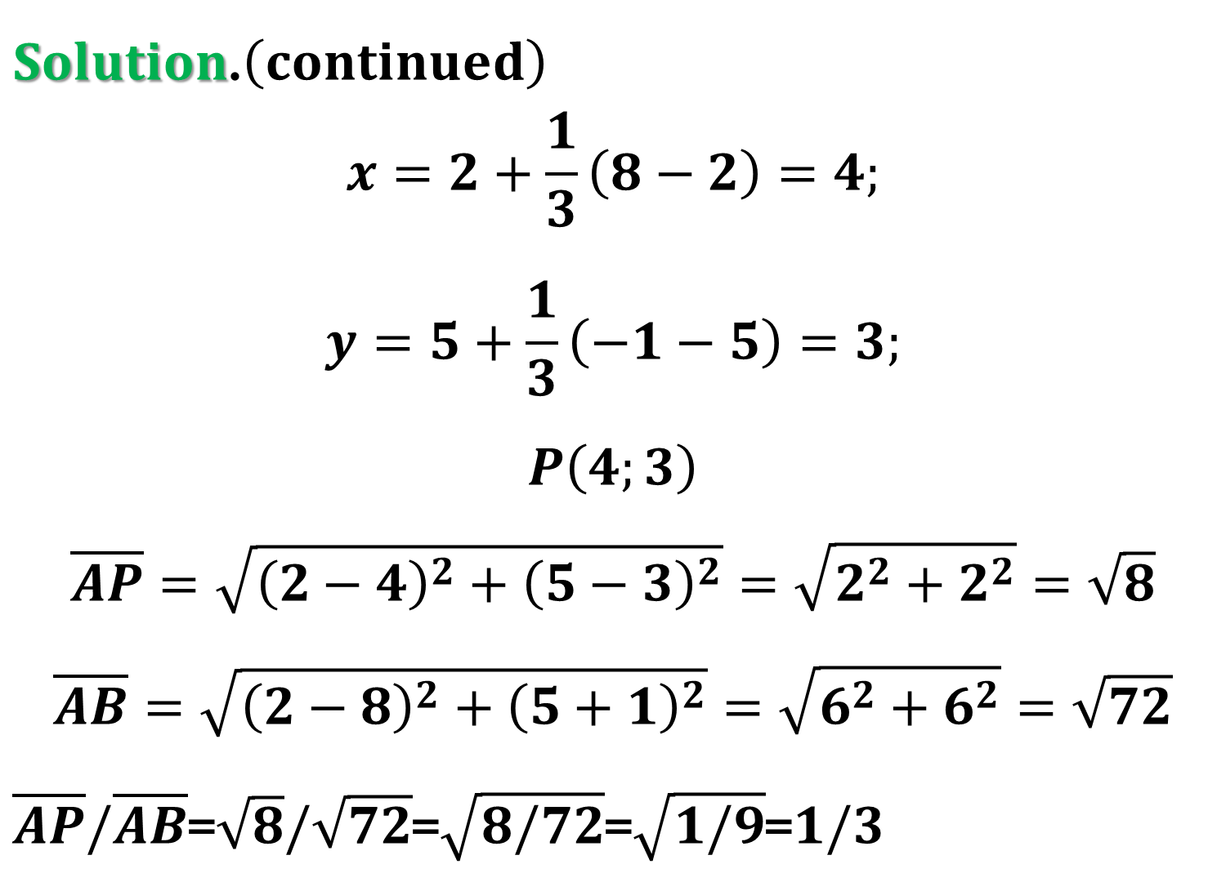
$Solution$.$\left(continued\right)$
$$x=2+\frac{1}{3}\left(8−2\right)=4;$$
$$y=5+\frac{1}{3}\left(−1−5\right)=3;$$
$$P\left(4;3\right)$$
$$\overline{AP}=\sqrt{{\left(2−4\right)}^{2}+{\left(5−3\right)}^{2}}=\sqrt{2^{2}+2^{2}}=\sqrt{8}$$
$$\overline{AB}=\sqrt{{\left(2−8\right)}^{2}+{\left(5+1\right)}^{2}}=\sqrt{6^{2}+6^{2}}=\sqrt{72}$$
$\overline{AP}/\overline{AB}$=$\sqrt{8}/\sqrt{72}$=$\sqrt{8/72}$=$\sqrt{1/9}$=$1/3$

Slide 16
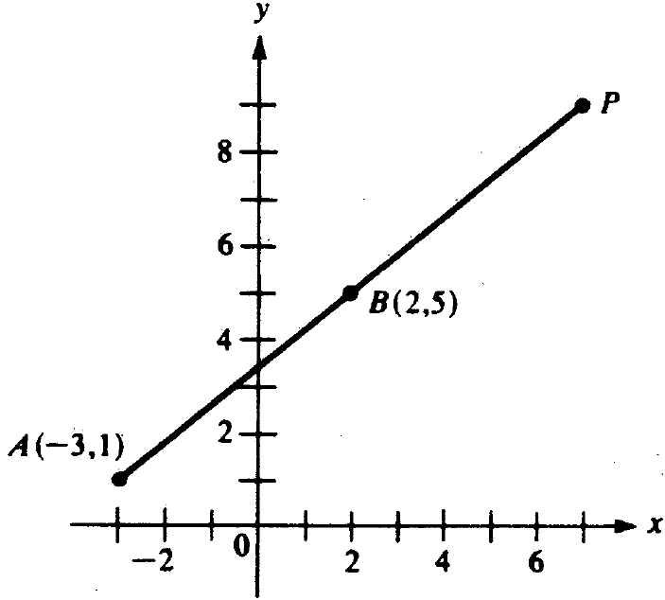
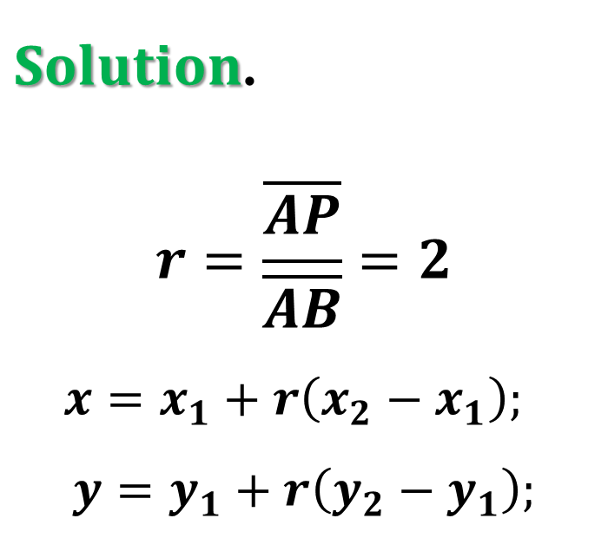
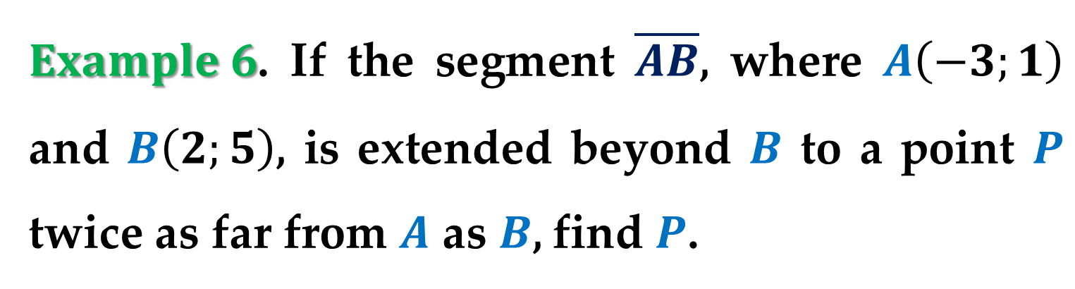
$Example 6$. If the segment $\overline{AB}$, where $A\left(−3;1\right)$ and $B\left(2;5\right)$, is extended beyond $B$ to a point $P$ twice as far from $A$ as $B$, find $P$.
$Solution$.
$$r=\frac{\overline{AP}}{\overline{AB}}=2$$
$$x=x_{1}+r\left(x_{2}−x_{1}\right);$$
$$y=y_{1}+r\left(y_{2}−y_{1}\right);$$

Slide 17
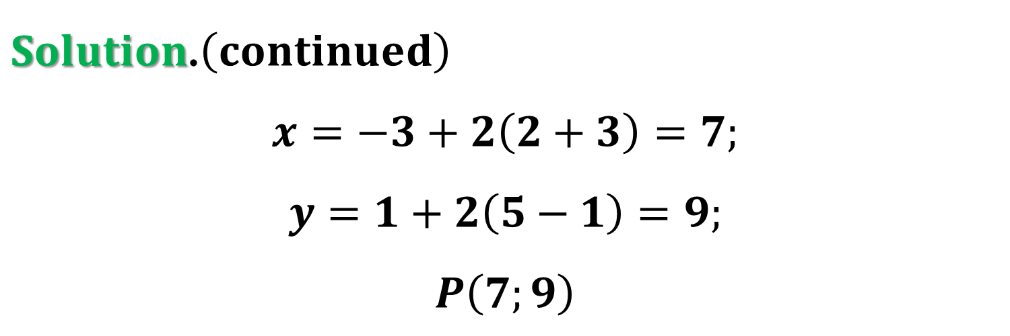
$Solution$.$\left(continued\right)$
$$x=−3+2\left(2+3\right)=7;$$
$$y=1+2\left(5−1\right)=9;$$
$$P\left(7;9\right)$$

Slide 18
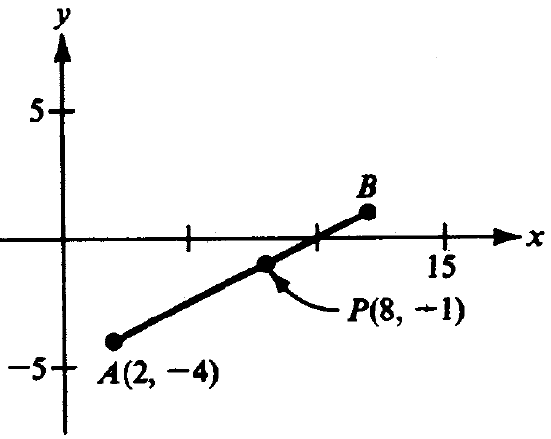
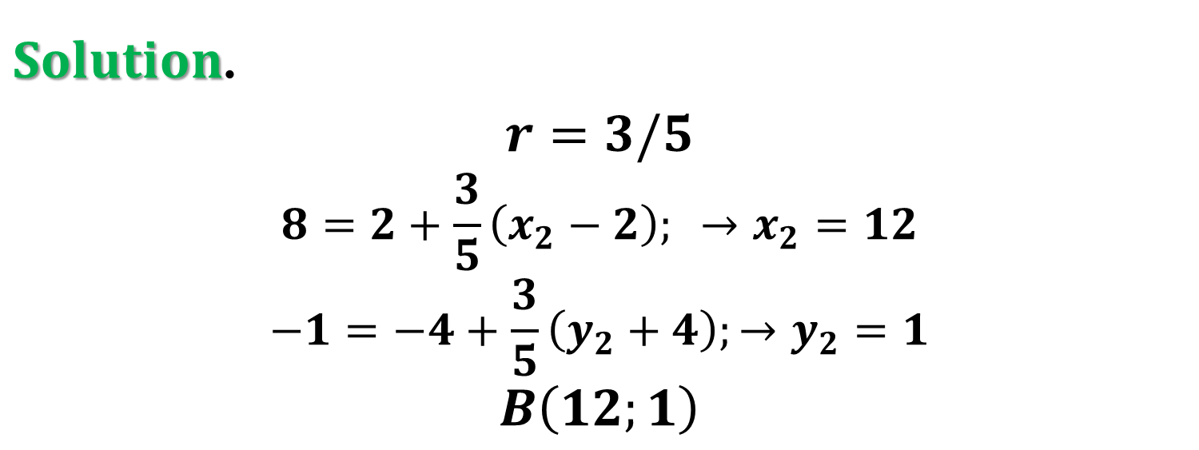
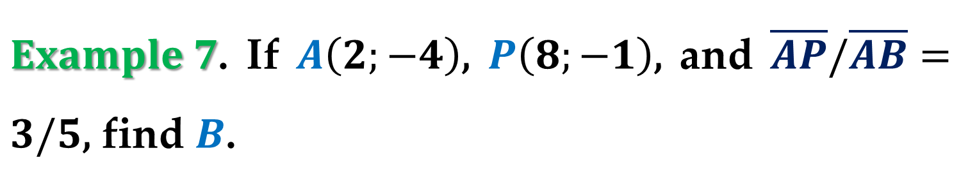
$Example 7$. If $A\left(2;−4\right)$, $P\left(8;−1\right)$, and $\overline{AP}/\overline{AB}=3/5$, find $B$.
$Solution$.
$$r=3/5$$
$$8=2+\frac{3}{5}\left(x_{2}−2\right); →x_{2}=12$$
$$−1=−4+\frac{3}{5}\left(y_{2}+4\right);→y_{2}=1$$
$$B\left(12;1\right)$$

Slide 19
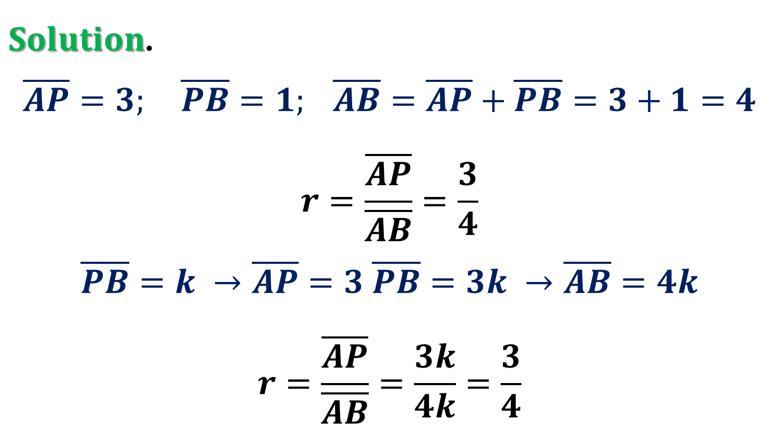
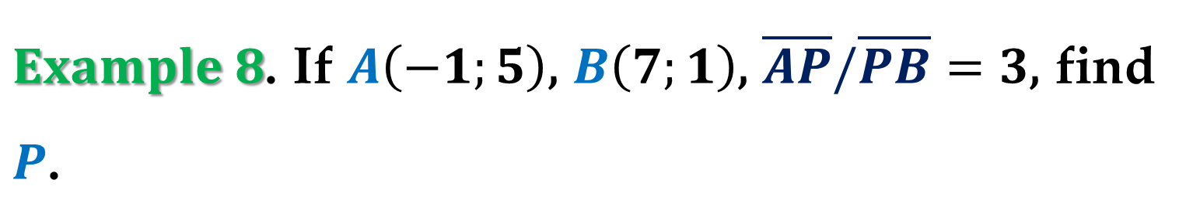
$Example 8$. If $A\left(−1;5\right)$, $B\left(7;1\right)$, $\overline{AP}/\overline{PB}=3$, find $P$.
$Solution$.
$$\overline{AP}=3; \overline{PB}=1; \overline{AB}=\overline{AP}+\overline{PB}=3+1=4$$
$$r=\frac{\overline{AP}}{\overline{AB}}=\frac{3}{4}$$
$$\overline{PB}=k →\overline{AP}=3 \overline{PB}=3k →\overline{AB}=4k$$
$$r=\frac{\overline{AP}}{\overline{AB}}=\frac{3k}{4k}=\frac{3}{4}$$

Slide 20
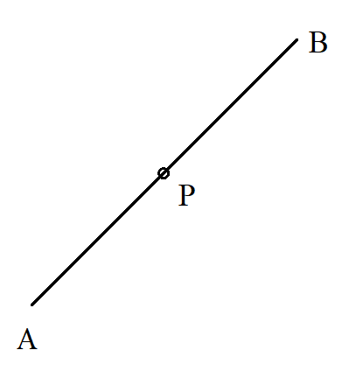
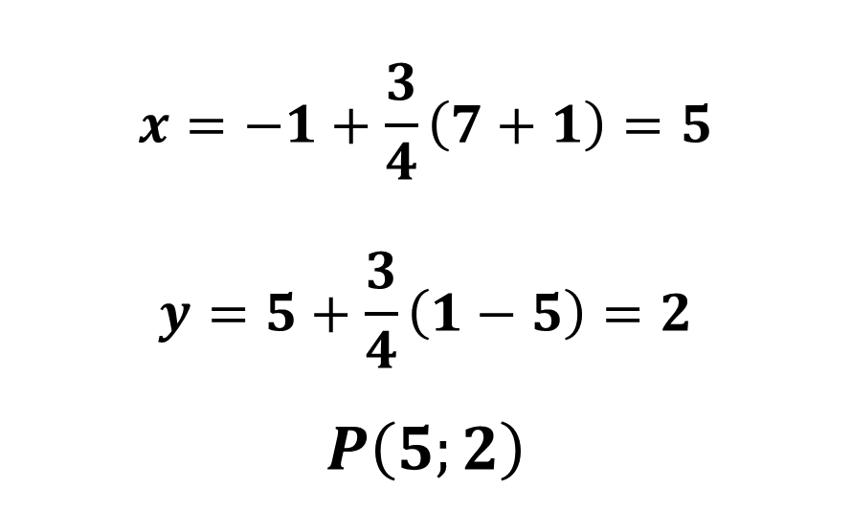
$$x=−1+\frac{3}{4}\left(7+1\right)=5$$
$$y=5+\frac{3}{4}\left(1−5\right)=2$$
$$P\left(5;2\right)$$

Slide 21
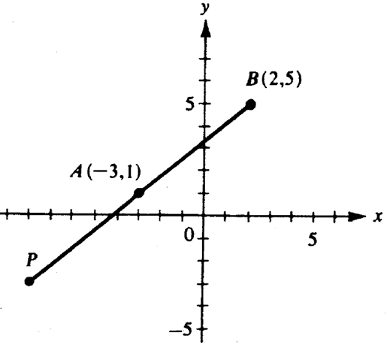

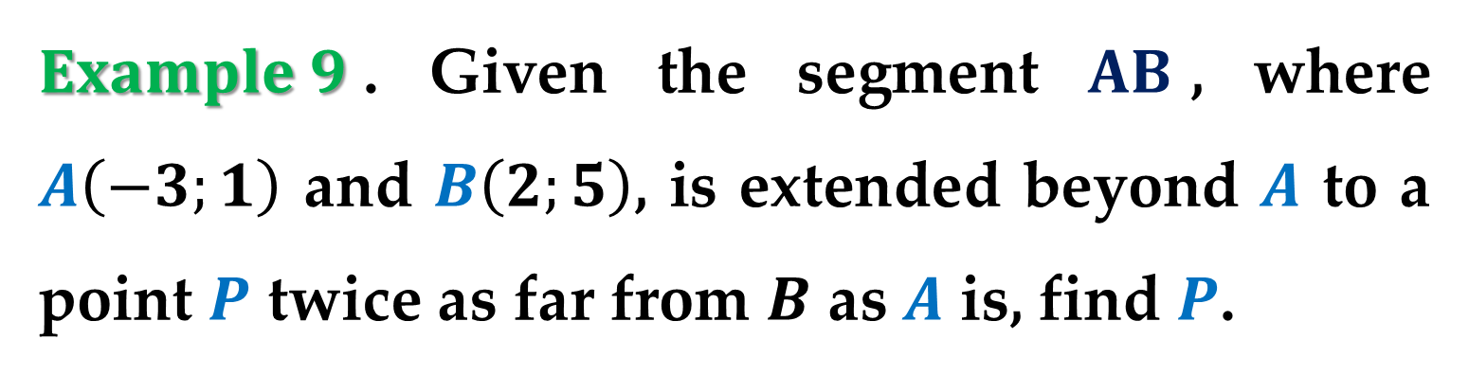
$Example 9$. Given the segment $AB$, where $A\left(−3;1\right)$ and $B\left(2;5\right)$, is extended beyond $A$ to a point $P$ twice as far from $B$ as $A$ is, find $P$.
$Solution$.
text

Slide 22

$r=\frac{PB}{BA}=\frac{2}{1}=2$
$x=x_{1}+r(x_{2}−x_{1})$
y$=y_{1}+r(y_{2}−y_{1})$
$x=2+2\left(−3−2\right)=−8$
$y=5+2\left(1−5\right)=−3$

Slide 23

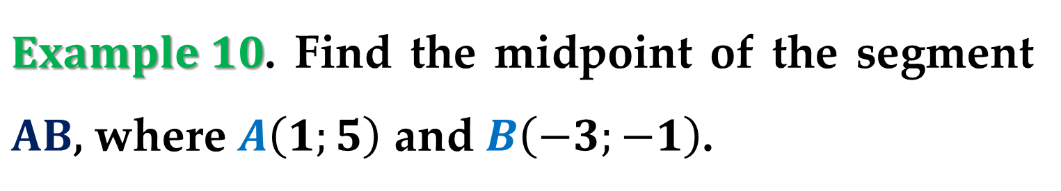
$Example 10$. Find the midpoint of the segment $AB$, where $A\left(1;5\right)$ and $B\left(−3;−1\right)$.
$Solution$.
text

Slide 24
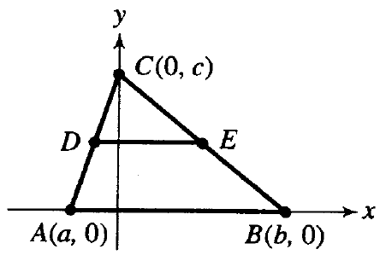
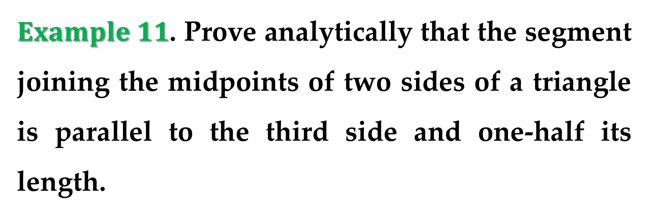
$Example 11$. Prove analytically that the segment joining the midpoints of two sides of a triangle is parallel to the third side and one-half its length.
$Solution$.
text

Slide 25

$Solution$.$\left(continued\right)$
text

Slide 26

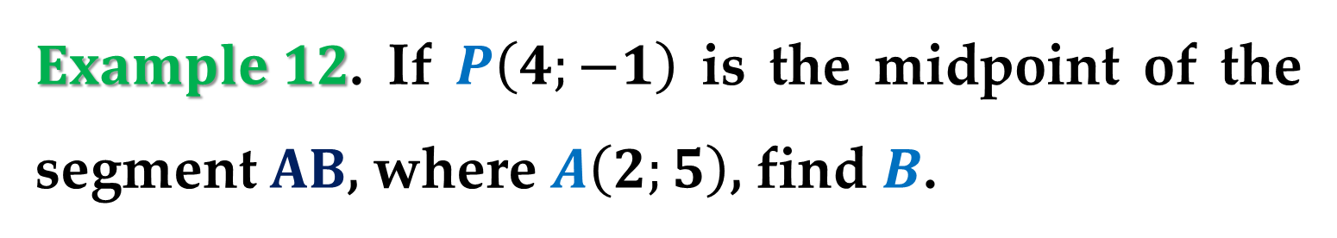
$Example 12$. If $P\left(4;−1\right)$ is the midpoint of the segment $AB$, where $A\left(2;5\right)$, find $B$.
$Solution$.
text

Slide 27
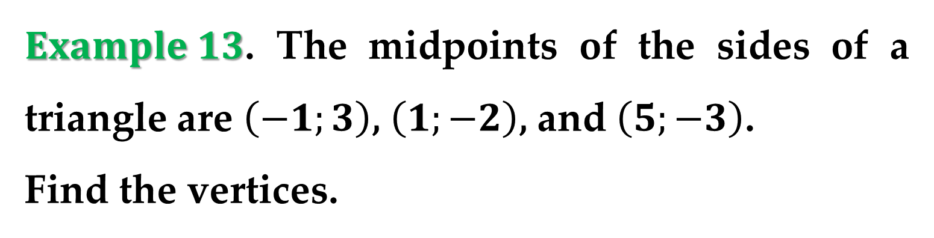
$Example 13$. The midpoints of the sides of a triangle are $\left(−1;3\right)$, $\left(1;−2\right)$, and $\left(5;−3\right)$.
Find the vertices.
$Solution$.
text

Slide 28
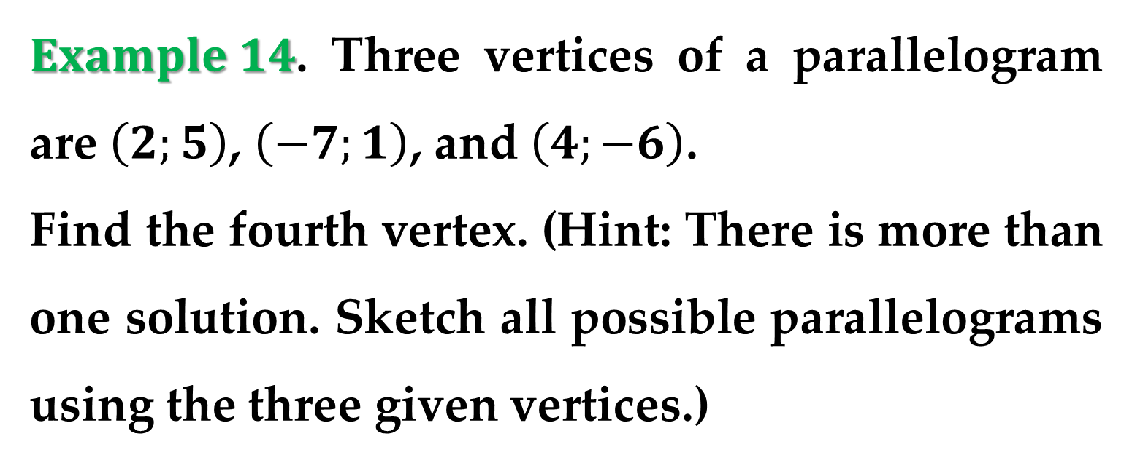
$Example 14$. Three vertices of a parallelogram are $\left(2;5\right)$, $\left(−7;1\right)$, and $\left(4;−6\right)$.
Find the fourth vertex. (Hint: There is more than one solution. Sketch all possible parallelograms using the three given vertices.)
$Solution$.
text

Slide 29
$Solution$.$\left(continued\right)$
text

Slide 30
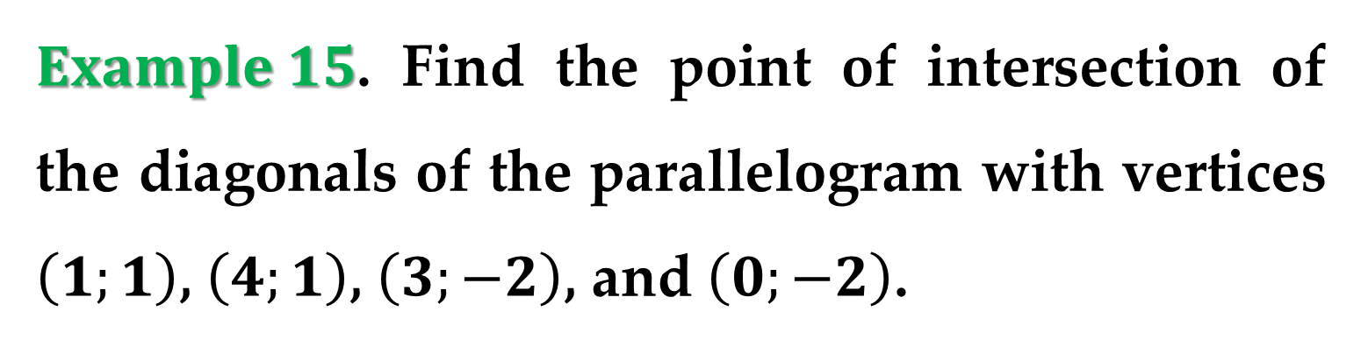
$Example 15$. Find the point of intersection of the diagonals of the parallelogram with vertices $\left(1;1\right)$, $\left(4;1\right)$, $\left(3;−2\right)$, and $\left(0;−2\right)$.
$Solution$.
text

Slide 32


$Example x$. text
$Solution$.
text

Slide 33
$Solution$.$\left(continued\right)$
text

Slide 34
text
text
text

